Slide 1
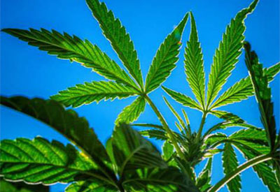
PRE-ACLM CONFERENCE DINNER PROGRAM
MARIJUANA (CANNABIS): THC AND CBD
FEDERAL AND STATE STATUTES, MEDICAL, ETHICAL AND LIABILITY ISSUES
Moderator:
Peter H. Rheinstein, MD, JD, MS
Chairman, ABLM
Co-Moderator:
Robert (Dr. Bob) Buckman, PhD
Chairman, ACLM Foundation
Program Chair:
S. Sandy Sanbar, MD, PhD, JD
Past President, ACLM
Past Chairman, ABLM

Slide 2
Why Is Marijuana Also Called Pot?
The origin of pot has nothing to do with the culinary tool. The word came into use in America in the late 1930s. It is a shortening of the Spanish potiguaya or potaguaya that came from potación de guaya, a wine or brandy in which marijuana buds have been steeped. It literally means “the drink of grief.”
https://www.dictionary.com/e/pot-marijuana

Slide 3
What is its legal status in the United States?
Marijuana is a Schedule I substance under the Controlled Substances Act, meaning that it has a high potential for abuse, no currently accepted medical use in treatment in the United States, and a lack of accepted safety for use under medical supervision. Although some states within the United States have allowed the use of marijuana for medicinal purpose, it is the U.S. Food and Drug Administration that has the federal authority to approve drugs for medicinal use in the U.S. To date, the FDA has not approved a marketing application for any marijuana product for any clinical indication.
DRUGS OF ABUSE I A DEA Resource Guide: 2017 EDITION

Slide 4
Moderator’s Handouts
Selected Pages from DEA Resource Guide
Arizona
Medical Marijuana Physician Certification
Physician Frequently Asked Questions
Maryland
Advertising Guidelines
Advertising Frequently Asked Questions

